Slide 1
God’s Word Revealed
Mountain Men

Slide 2
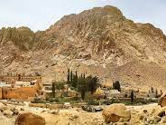
Exalt the LORD our God, and worship at his holy mountain; for the LORD our God is holy!
Psalm 99:9
We will sit at the foot of the mountain of God’s Holy Word, studying major doctrine and discussing its application to our lives.

Slide 3
God’s View of the World, His Wisdom...
In God’s design and wisdom, He sought from the beginning for us to go forth and multiply His Image among Creation, and fill the earth with His glory!
So God created man in his own image, in the image of God he created him; male and female he created them. And God blessed them. And God said to them, "Be fruitful and multiply and fill the earth and subdue it.”
Genesis 1:27-28 ESV

Slide 4
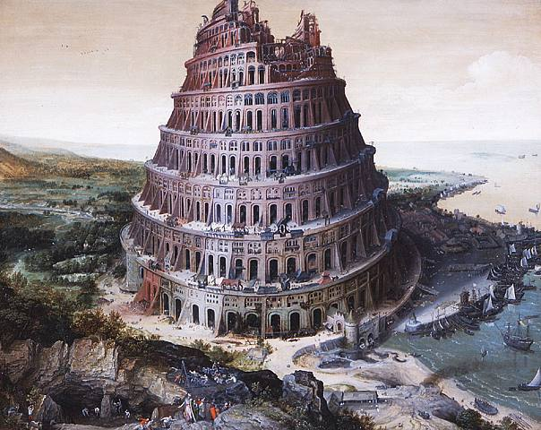
Man’s View of the World, His Wisdom...
“"Come, let us build ourselves a city and a tower with its top in the heavens, and let us make a name for ourselves, lest we be dispersed over the face of the whole earth.”
Genesis 11:4

Slide 5
Lets Unpack this a Little
Two General Observations can be made about all peoples in the world around us without reading a verse of the Bible

Slide 6
General Observation 1
People can see and sense a higher power, or things greater than them, in the world around them.

Slide 7
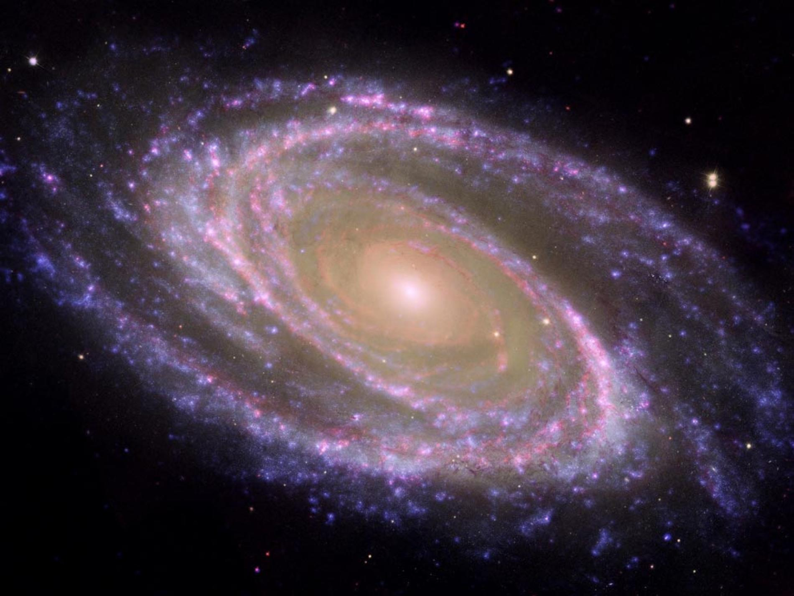
Seen in the beauty and vastness of creation

Slide 10
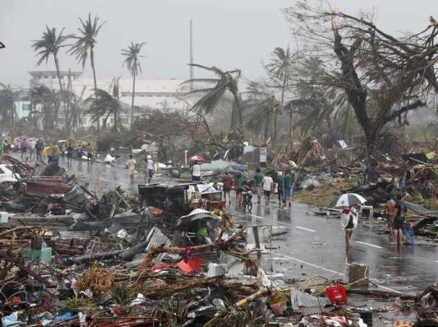
And We Can See the Forces of Nature

Slide 11
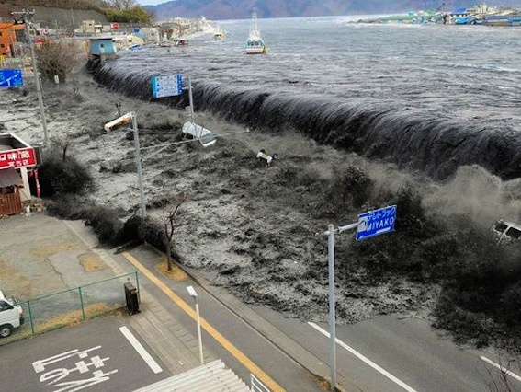

Slide 12
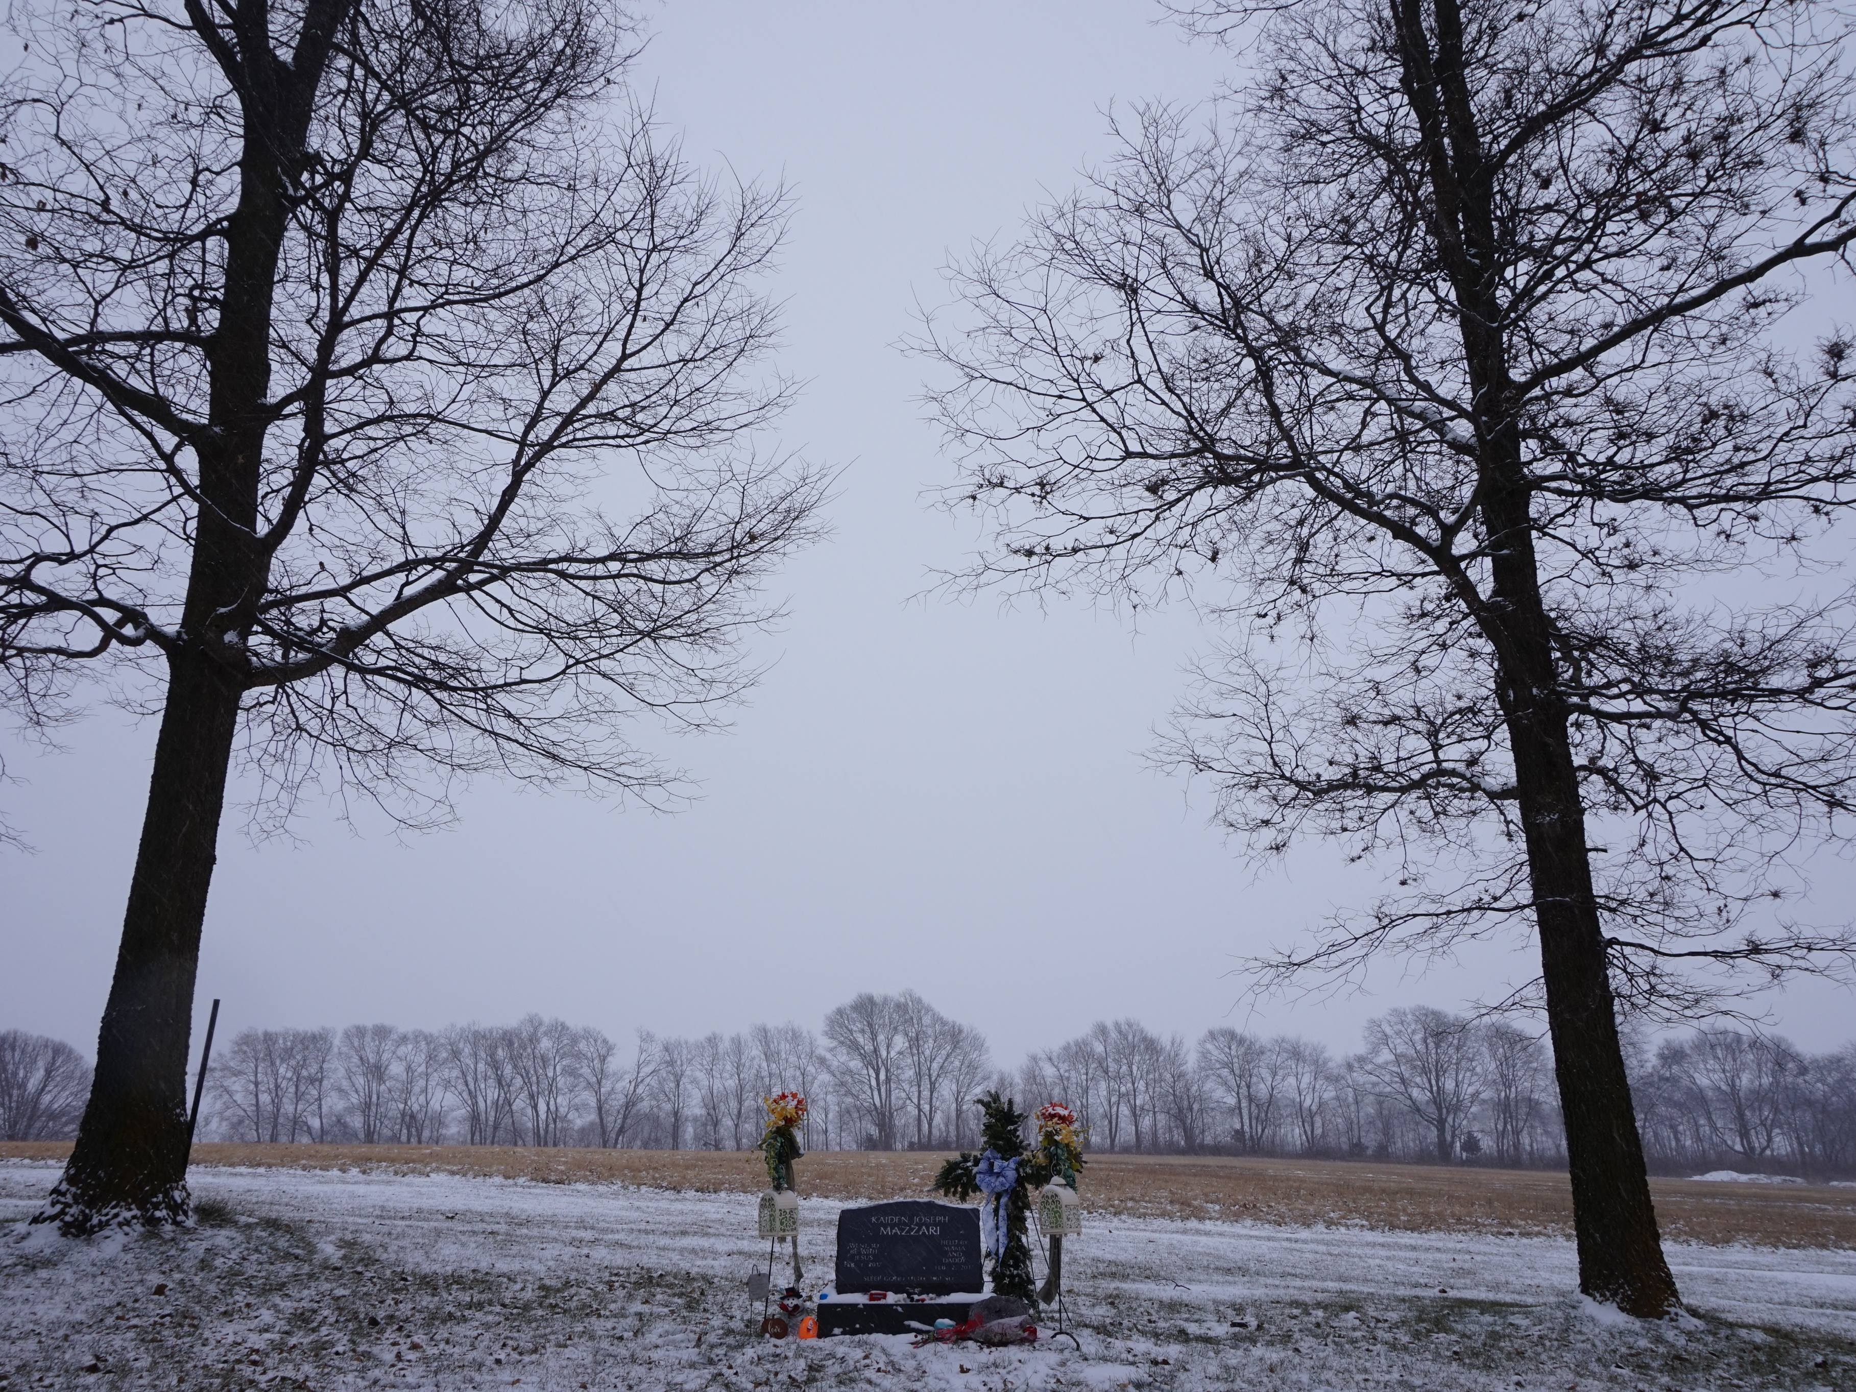

Slide 13
General Revelation of God
This is termed the General Revelation of God to His creation
“For his invisible attributes, namely, his eternal power and divine nature, have been clearly perceived, ever since the creation of the world, in the things that have been made. So they are without excuse.”
Romans 1:20 ESV

Slide 14
General Revelation of God
“The heavens declare the glory of God, and the sky above proclaims his handiwork.”
Psalm 19:1
“General Revelation is God’s witness of Himself through the creation to his creatures. Creation’s witness to the Creator is constant”
MacArthur, Bible Doctrine, 72

Slide 15
General Observation 2
That people can sense at some level in their hearts that choices and actions are morally right and wrong.

Slide 16
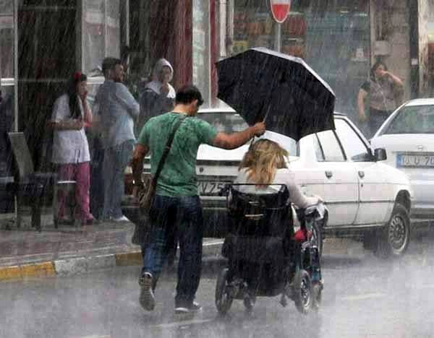

Slide 17
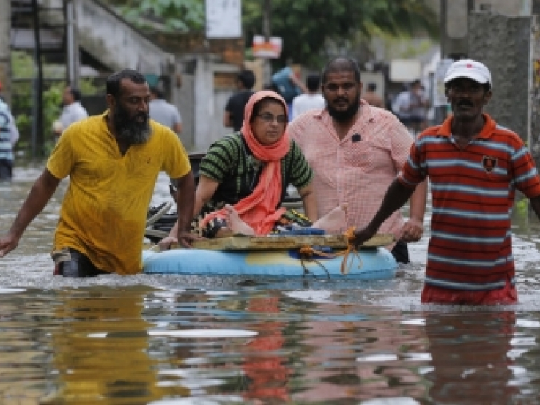

Slide 20
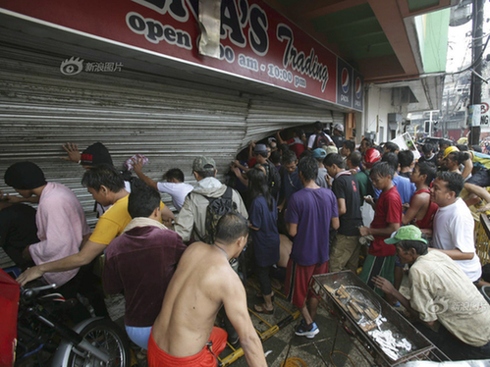

Slide 22
General Revelation of Morality
“For when Gentiles, who do not have the law, by nature do what the law requires, they are a law to themselves, even though they do not have the law. They show that the work of the law is written on their hearts, while their conscience also bears witness, and their conflicting thoughts accuse or even excuse them.”
Romans 2:14-15

Slide 23
General Revelation of Morality
“To the pure, all things are pure, but to the defiled and unbelieving, nothing is pure; but both their minds and their consciences are defiled. ”
Titus 1:15

Slide 24
General Revelation of Morality
“The natural person does not accept the things of the Spirit of God, for they are folly to him, and he is not able to understand them because they are spiritually discerned.”
I Corinthians 2:14
“The inherent knowledge [in each person] of right and wrong and the work of the conscience, which accuses sinners so that they stand condemned before their Creator and Judge.”
MacArthur, Bible Doctrine, 73

Slide 25
There are three general responses and views relative to these two general observations in the world around us

Slide 26
IMPORTANT!:
The sources people take as their truth relative to these two observations in life informs their response. This defines their worldview and forms the basis of their behavior in this world

Slide 27
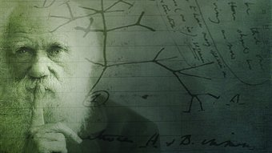
Man’s Wisdom...
Naturalism
Натурализм

Slide 28
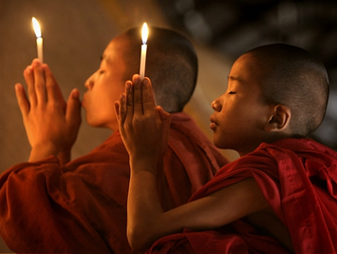
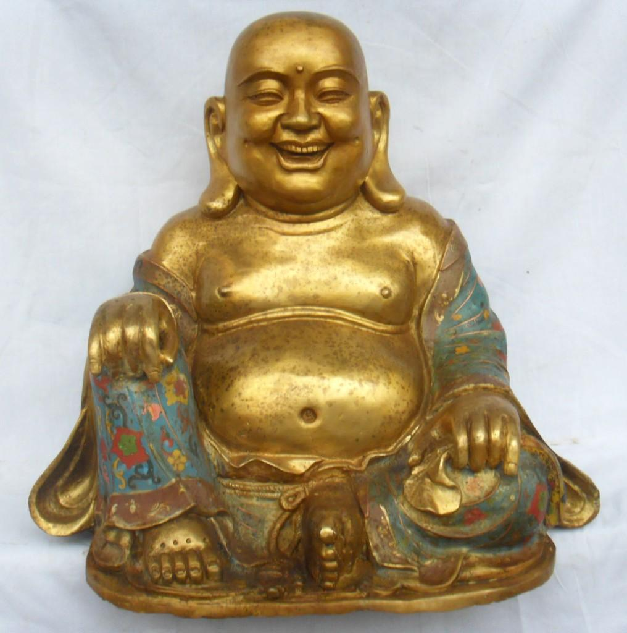
Man’s Wisdom...
Religion Based on Wisdom
Религия на основе мудрости

Slide 29
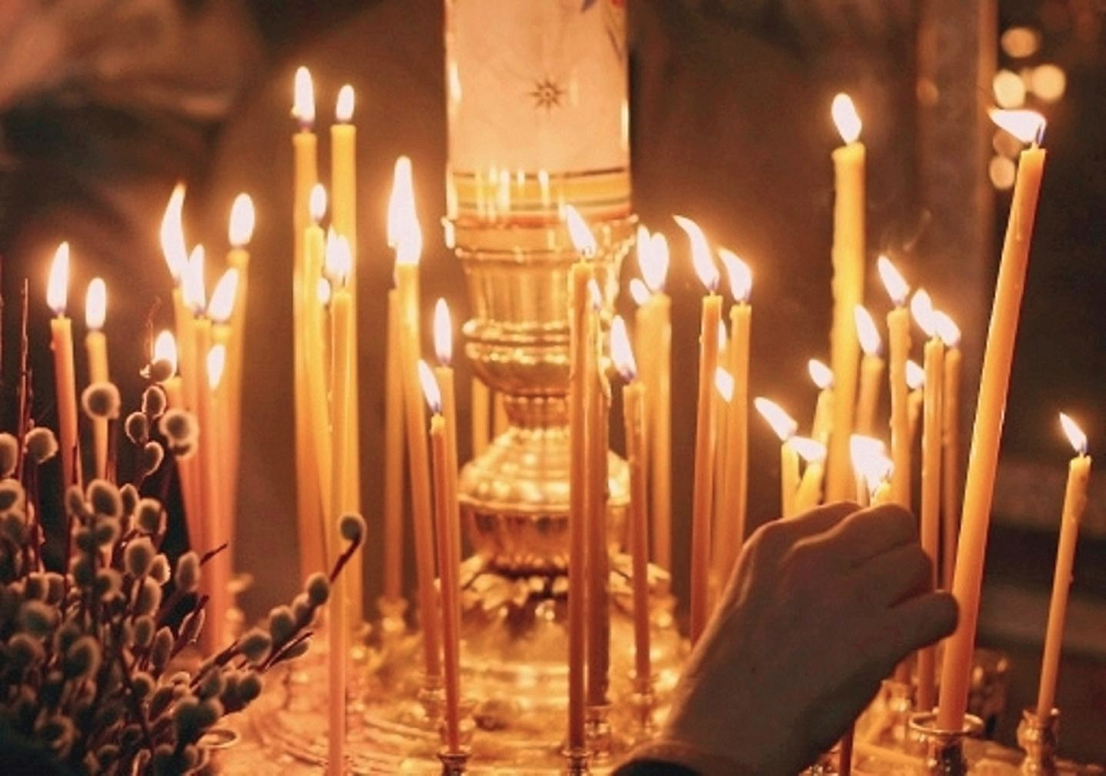
God’s Wisdom?
Religion Based on Revelation
Религия основанная на откровении

Slide 30
Special Revelation
“Long ago, at many times and in many ways, God spoke to our fathers by the prophets, but in these last days he has spoken to us by his Son, whom he appointed the heir of all things, through whom also he created the world.”
Hebrews 1:1-2
God uses special revelation when He reveals Himself directly and in greater detail. God has revealed Himself by direct acts at various times and in varied ways throughout redemptive history.
MacArthur, Bible Doctrine, 74

Slide 31
God’s Wisdom?
Religion Based on Revelation

Slide 32
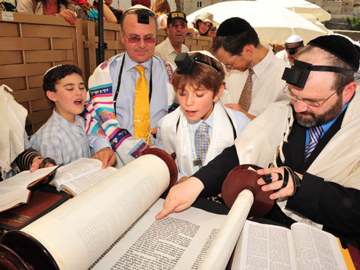
Religion Based on Revelation

Slide 33
And so religions based on revelation from God can be further broken down in two further ways

Slide 34
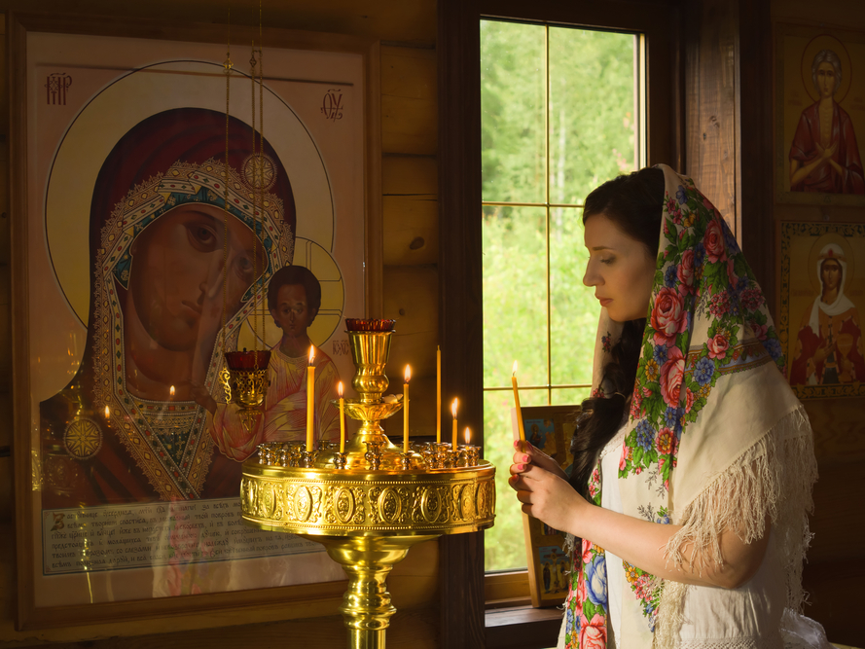
Man’s or God’s Wisdom?
Defined by how they see that one can walk rightly before God

Slide 35
Man’s or God’s Wisdom?
View 1: Works of Righteousness to Please God

Slide 36
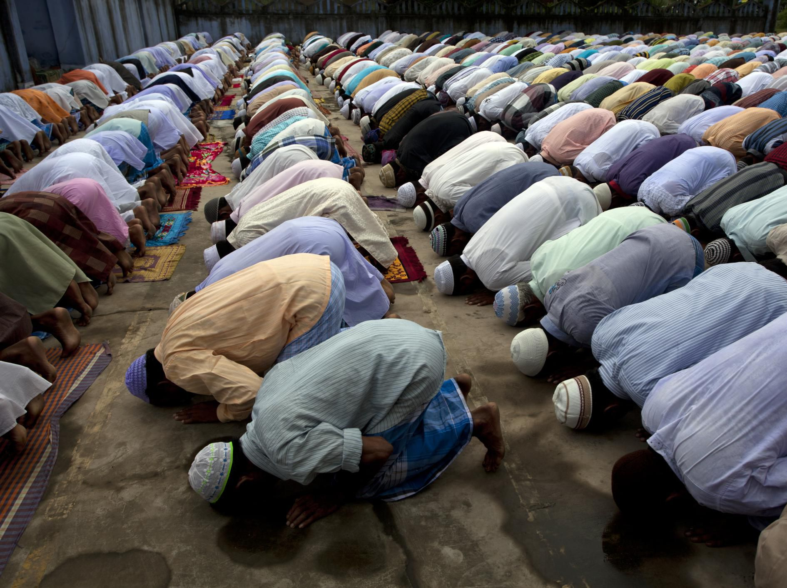
Works of Righteousness to Please God

Slide 37
Works of Righteousness to Please God

Slide 38
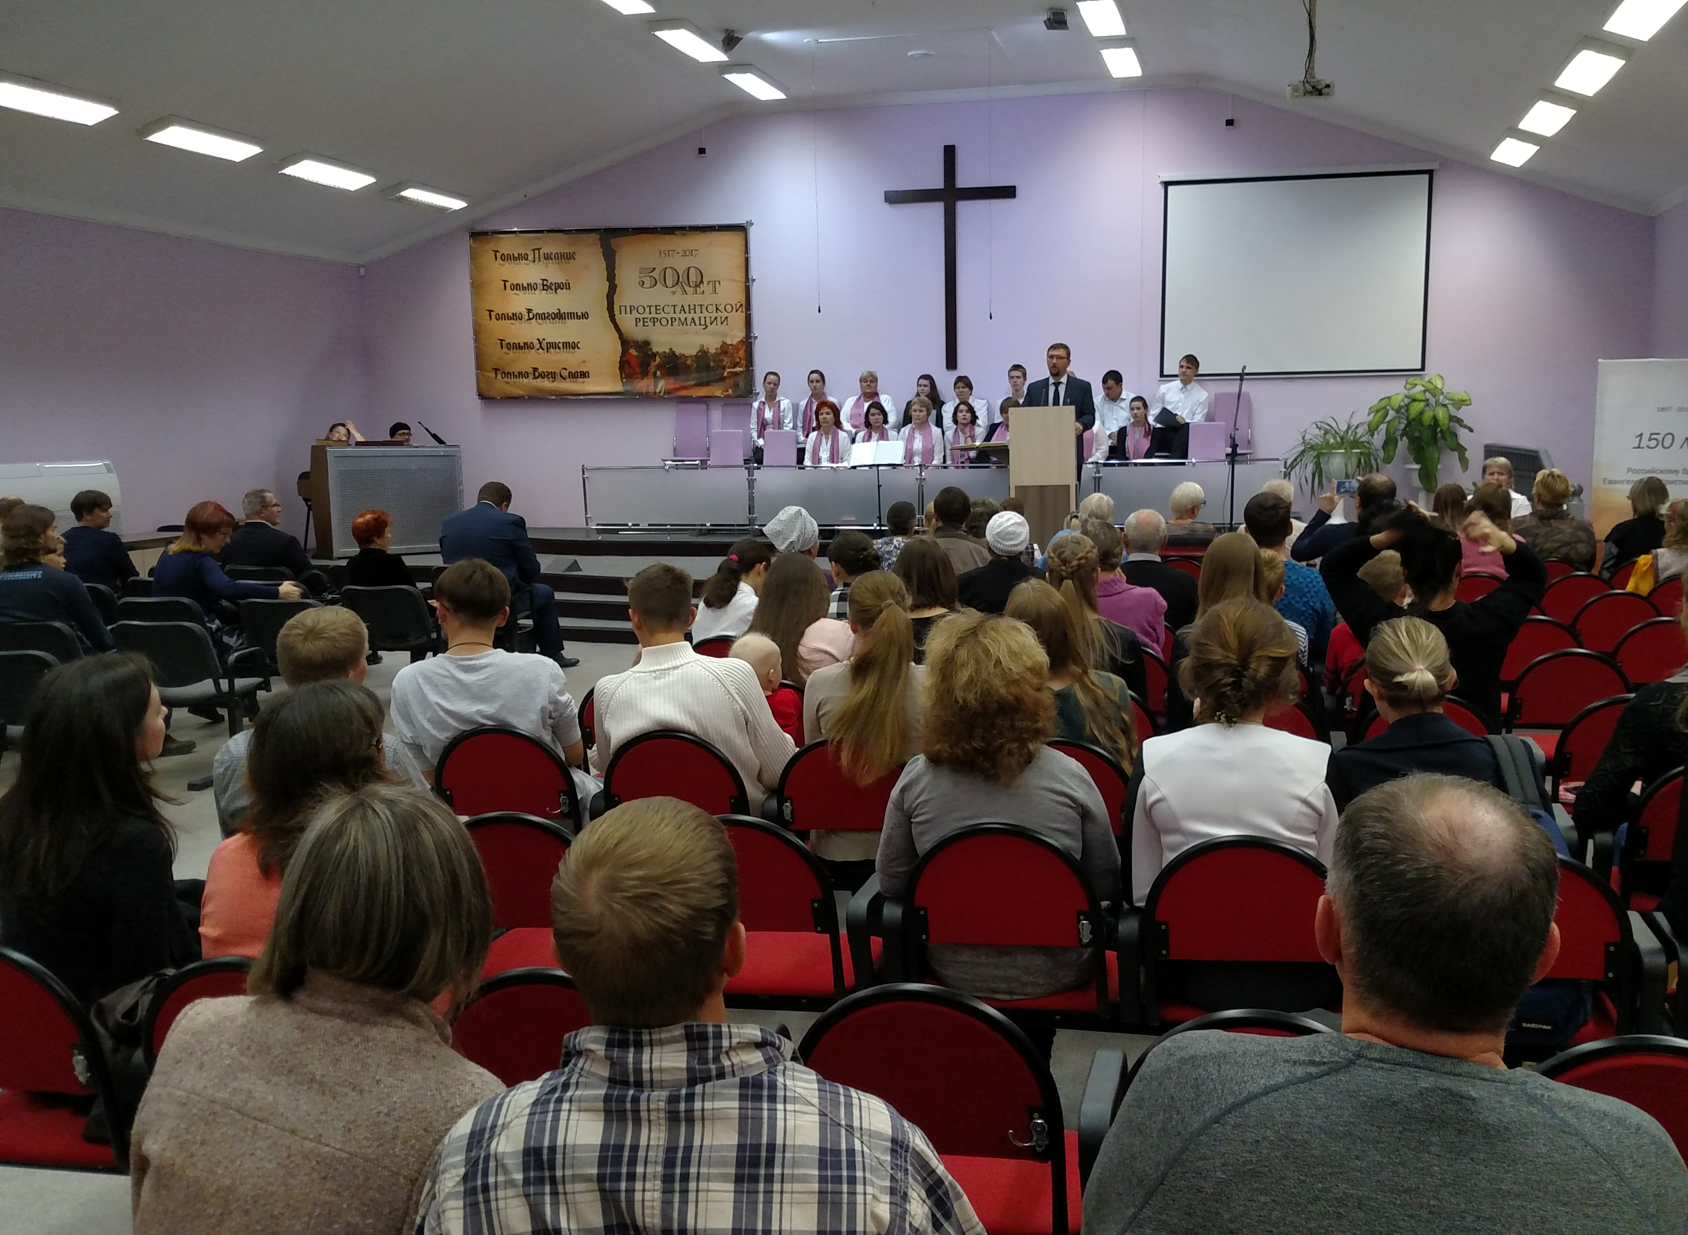
Then There Is Righteousness Imputed from God

Slide 39
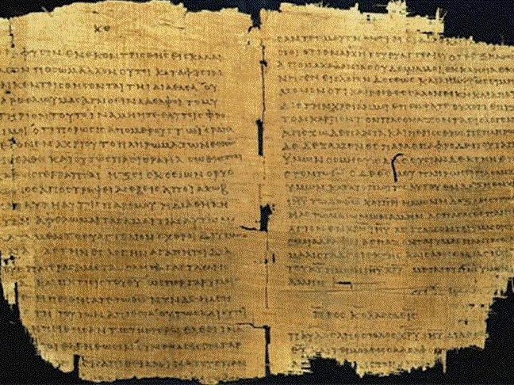
God’s Wisdom or Man’s...
Going Deeper: These positions flow from differing sources of revelation to guide walking rightly before God

Slide 40
Source: The Bible + Human Works
The Bible
The Apocrypha (Divine, but Not Inspired)
Apostolic Tradition (Religious Instructions and Teachings)
Magisterium (Direction of Current Pope and Leaders)

Slide 41
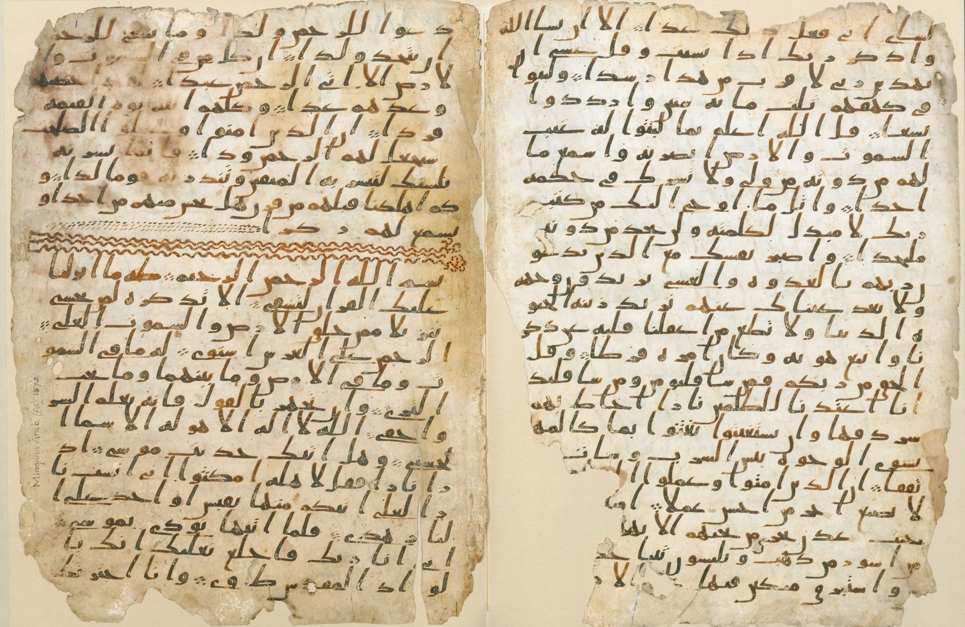
Source: The Quran + Human Works
The Quran (Compiled after death of Mohammed)
The Hadith (Supposed Oral Teachings of Mohammed)
The Sunnah (Religious Instructions and Teachings)

Slide 42
Hope through Works
Quran teaches that salvation is based on purification by good deeds and following the teachings.
“We will certainly question those who received the message, and we will question the messengers. We will inform them authoritatively, for we were never absent. The scales will be set on that day, equitably. Those whose weights are heavy will be the winners. As for those whose weights are light, they will be the ones who lost their souls as a consequence of disregarding our revelations, unjustly. (7:6-9)
“With GOD is the knowledge about the Hour (end of the world). He is the One who sends down the rain, and He knows the contents of the womb. No soul knows what will happen to it tomorrow, and no one knows in which land he or she will die. GOD is Omniscient, Cognizant. .” (31:34)

Slide 43
From the Hadith (Sunni, Shia, Sufi flow from this)
Collection of Sayings of Mohammad
Collected as late as 200 years after his death and after apostate wars - launched by the Caliph Abu Bakr against rebel Arabian tribes during 632 and 633, just after Muhammad died
“Mohammad said, "I have been ordered to fight with the people till they say, ‘None has the right to be worshiped but Allah,’ and whoever says, ‘None has the right to be worshiped by Allah,’ his life and property will be saved by me except for Islamic law, and his accounts will be with Allah (either to punish him or to forgive him.)"”
4:196
“Muhammad said, "The person who participates in (holy battles) in Allah's cause and nothing compels him to do so except belief in Allah and His Apostles, will be recompensed by Allah either with a reward, or booty (if he survives) or will be admitted to Paradise (if he is killed in the battle as a martyr).”
1:35

Slide 44
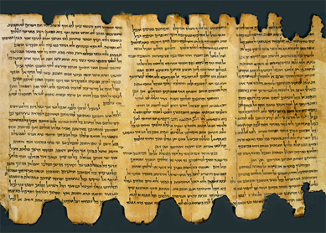
Source: The Tanakh + Human Works
Hebrew Bible (Tanakh or Torah)
Mishnah (190AD) Oral Torah or Teaching
Talmud (500AD) Mishnah + More Rabbinic Teaching
“… in vain do they worship me, teaching as doctrines the commandments of men.' You leave the commandment of God and hold to the tradition of men.”
Mark 7:7-8

Slide 45
Source: The Bible Alone.

Slide 46
Special Revelation
Again, Divine Revelation
“All Scripture is breathed out by God and profitable for teaching, for reproof, for correction, and for training in righteousness, that the man of God may be complete, equipped for every good work.”
II Timothy 3:16-17

Slide 47
Five Important Distinctives Regarding Special Revelation
Inspiration
Inerrancy
Infallibility
Sufficiency
Authority
So therefore, we can further divide where one stands on God’s Special Revelation as the source or foundation for your worldview this again has great bearing on your response to the world around you.

Slide 48
Inspiration
“The whole of Scripture and all its parts, down to the very words of the original manuscripts, were given by divine inspiration.
Chicago Statement on Inerrancy, Article 6

Slide 49
Inspiration
Inspiration guaranteed true and trustworthy utterance on all matters of which the Biblical authors were moved to speak and write.”
Chicago Statement on Inerrancy, Article 9

Slide 50
Inspiration
It denies that the finitude or fallenness of these writers, by necessity or otherwise, introduced distortion or falsehood into God's Word.”
Chicago Statement on Inerrancy, Article 9

Slide 51
Inerrant
“Scripture in its entirety is inerrant, being free from falsehood, fraud, or deceit. It denies that Biblical infallibility and inerrancy are limited to spiritual, religious, or redemptive themes, exclusive of assertions in the fields of history and science. We further deny that scientific hypotheses about earth history may properly be used to overturn the teaching of Scripture on creation and the flood.”
Chicago Statement on Inerrancy, Article 12

Slide 52
Infallible
“We affirm that Scripture, having been given by divine inspiration, is infallible, so that, far from misleading us, it is true and reliable in all the matters it addresses.”
Chicago Statement on Inerrancy, Article 11

Slide 53
Sufficient
“The whole counsel of God concerning all things necessary for His own glory, man’s salvation, faith and life, is either expressly set down in Scripture, or by good and necessary consequence may be deduced from Scripture: unto which nothing at any time is to be added, whether by new revelations of the Spirit, or traditions of men.”
Westminster Confession of Faith, 1.6

Slide 54
Authoritative
“Scripture is first and foremost the “Word of God”, not the “word of men.” The authority of Scripture is directly derived from the authority of God Himself. This declaration places the authority not with the preacher, but rather with God.”
MacArthur, Bible Doctrine, 100-107

Slide 55
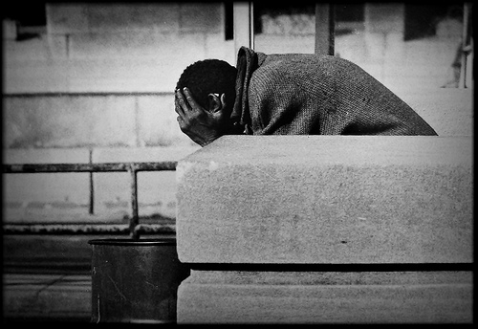
Yet with all this revelation
hopeless prevails

Slide 56
People still have many questions about who they are and why their life even matters.

Slide 57
So what we believe about God and His revealed Word shapes our response to them

